Slide 1
DESIGN (ANTI-)PATTERNS
Chain of Responsibility

Slide 2
WHAT ARE DESIGN PATTERNS
A software design pattern is a general, reusable solution to a commonly occurring problem. It is not a finished design that can be transformed directly into source or machine code. It is a description or template for how to solve a problem that can be used in many different situations. Design patterns are formalized best practices that the programmer can use to solve common problems when designing an application or system.
Types
Creational (singleton, builder, lazy init, abstract factory, object pool etc.)
Structural (adapter, bridge, decorator, facade, composite, proxy etc.)
Behavioral (iterator, strategy, template method, visitor, command etc.)
Concurrency (thread pool, double checked locking, monitor object, reactor etc.)

Slide 3
Chain of Responsibility
Peter Kajsa

Slide 4
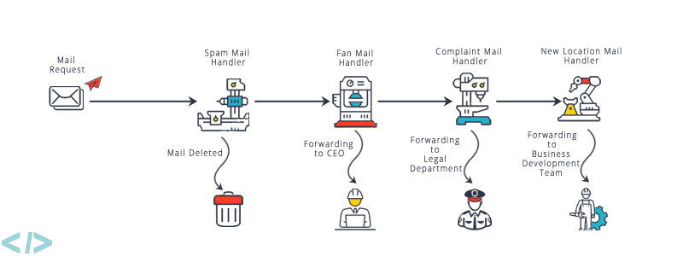
Chain of Responsibility

Slide 5
Chain of Responsibility
GoF Definition
“Avoid coupling the sender of a request to its receiver by giving more than one object a chance to handle the request. Chain the receiving objects and pass the request along the chain until an object handles it.” (Design Patterns: Elements of Reusable Object-Oriented Software)
What is the Chain of Responsibility pattern good for?
When we want to decouple a sender and receiver of a request
When multiple objects (determined at runtime) are candidates to handle a request and we don’t want to specify handlers or the receiver explicitly.
When we want to issue a request to one of several objects and we don’t care which one of them handle this request

Slide 6
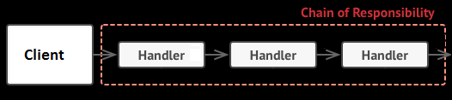
Chain of Responsibility
Concept
CoR consists of sequence of loosely coupled programming units i.e. handler objects linked together into a chain.
Client initiates a request and passes it to a handler in the chain.
Each handler performs its processing logic and then potentially passes the processing request onto the next link (i.e. handler) in the chain.

Slide 7
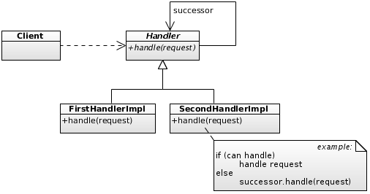
Participants
Class diagram
Client – initiates request to a ConcreteHandler in the chain.
Handler – defines interface for handling of requests.
ConcreteHandler – handles requests it is responsible for, otherwise forwards requests to successor.

Slide 8
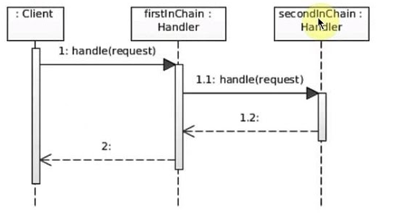
Participants
Sequence diagram
Client – initiates request to a ConcreteHandler in the chain.
ConcreteHandler – handles requests it is responsible for, otherwise forwards requests to successor.

Slide 9
Chain of Responsibility Demo – Simple Logger

Slide 10
Chain of Responsibility
Benefits
client is de-coupled from the chain mechanism
we can introduce new handlers into the chain without breaking the existing client code.
we can change the chain at runtime.
handlers are loosely coupled (a handler does not have knowledge of other handler logic)
CoR replaces long and complex if-else statements - each logical block is placed in a separate handler in the chain with the benefit that the logic can be dynamically rearranged and reconfigured at runtime.

Slide 11
Chain of Responsibility
Pitfalls
chain can get broken easily, if it is not configured properly
a request can be dropped - it is not handled at all by any handler (however, it can be valid use case in some cases)
improper configuration of chain can lead to a cycle (infinite recursion) ()
If the chain is too long, it can create deep stack traces, which can affect performance and debugging

Slide 12
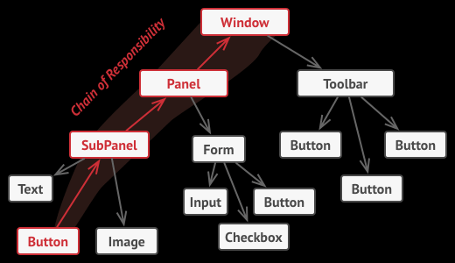
Chain of Responsibility
Pattern variations
A request can be handled by exactly one handler or more handlers or none of the handlers
A client may either assemble chains on its own or receive pre-built chains from other objects.
Chain of Reponsibility is often applied in together with Composite pattern (component's parent acts as its successor)

Slide 13
Chain of Responsibility
Examples in Java SE
java.util.logging.Logger#log()
javax.servlet.Filter#doFilter()

Slide 14
Chain of Responsibility
References
Design Patterns: Elements of Reusable Object-Oriented Software by Design Patterns: Elements of Reusable Object-Oriented Software by ErichGamma, RichardHelm, RalphJohnson, and JohnVlissides (the GangOfFour)
https://refactoring.guru/design-patterns/chain-of-responsibility
https://www.codeproject.com/Articles/39166/Using-the-Chain-Of-Command-Design-Pattern-Concepts
https://www.baeldung.com/chain-of-responsibility-pattern
https://springframework.guru/gang-of-four-design-patterns/chain-of-responsibility-pattern/
https://www.tutorialspoint.com/design_pattern/chain_of_responsibility_pattern.htm
https://en.wikipedia.org/wiki/Chain-of-responsibility_pattern
https://www.codenuclear.com/chain-of-responsibility-design-pattern-in-java/

Slide 15
Chain of Responsibility
Questions and discussion

